Slide 1
Chapter 12: Simple Linear Regression
Textbook: Ahmad Daryanto, Introduction to Quantitative Research Methods for Marketing With SPSS and R: Tools and Techniques, Routledge. 2024

Slide 2
Learning Objectives
Understand the concept of simple linear regression.
Able to distinguish between independent and dependent variables.
Know how to intepret the meaning of the regression coefficient.
Able explain the key assumptions of simple linear regression, which includes linearity, homoskedasticity, no auto-correlation, no endogeneity, and normality.
Able to use simple linear regression to assess mean differences.
Able to interpret the regression coefficient of the log-linear and log-log simple linear model.

Slide 3
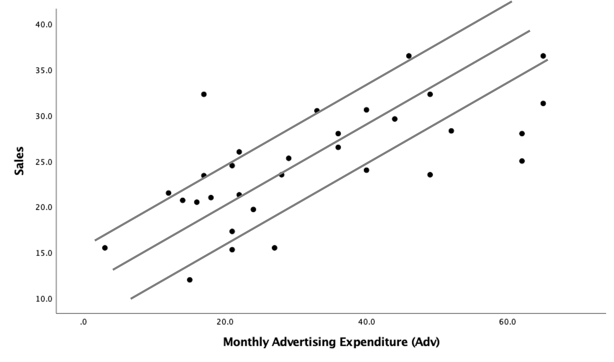
Which Line is Best?
Finding the best line by manually drawing a line on a graph is an error-prone endeavor. Any individuals will draw a different line and yet declare their lines are the best! To overcome this subjectivity, any statistical software such as SPSS can help you finding the best line. From this point onward, the best line is referred to as the best regression line as it is found by applying a method called called regression.

Slide 4
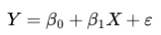
Finding the Best Line
If two variables are linearly related, if we plot pair of their values in a coordinate system - the resulting graph is called a scatter plot,
Finding the best straight line to summarize a relationship between two variables is about building a linear regression model used to estimate a population model. A simple regression model takes the form:
is always reserved as an independent variable, and Y as a dependent variable.

Slide 5
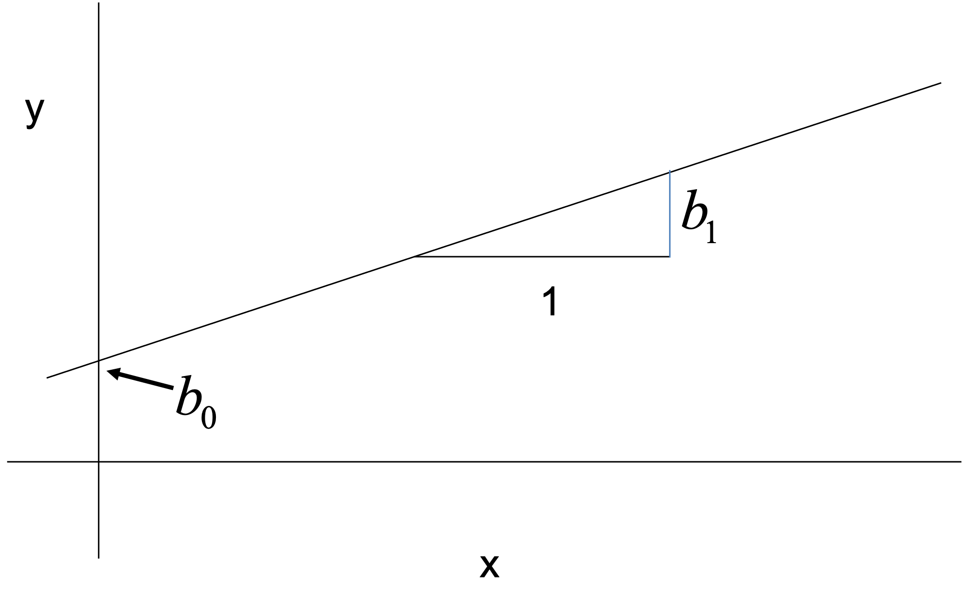
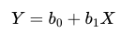
Simple Linear Regression
Using a random sample, the above population model is estimated by a sample regression line, which is the best line illustrated above
where b0 and b1 are regression coefficients or estimates that are varied from sample to sample.

Slide 6
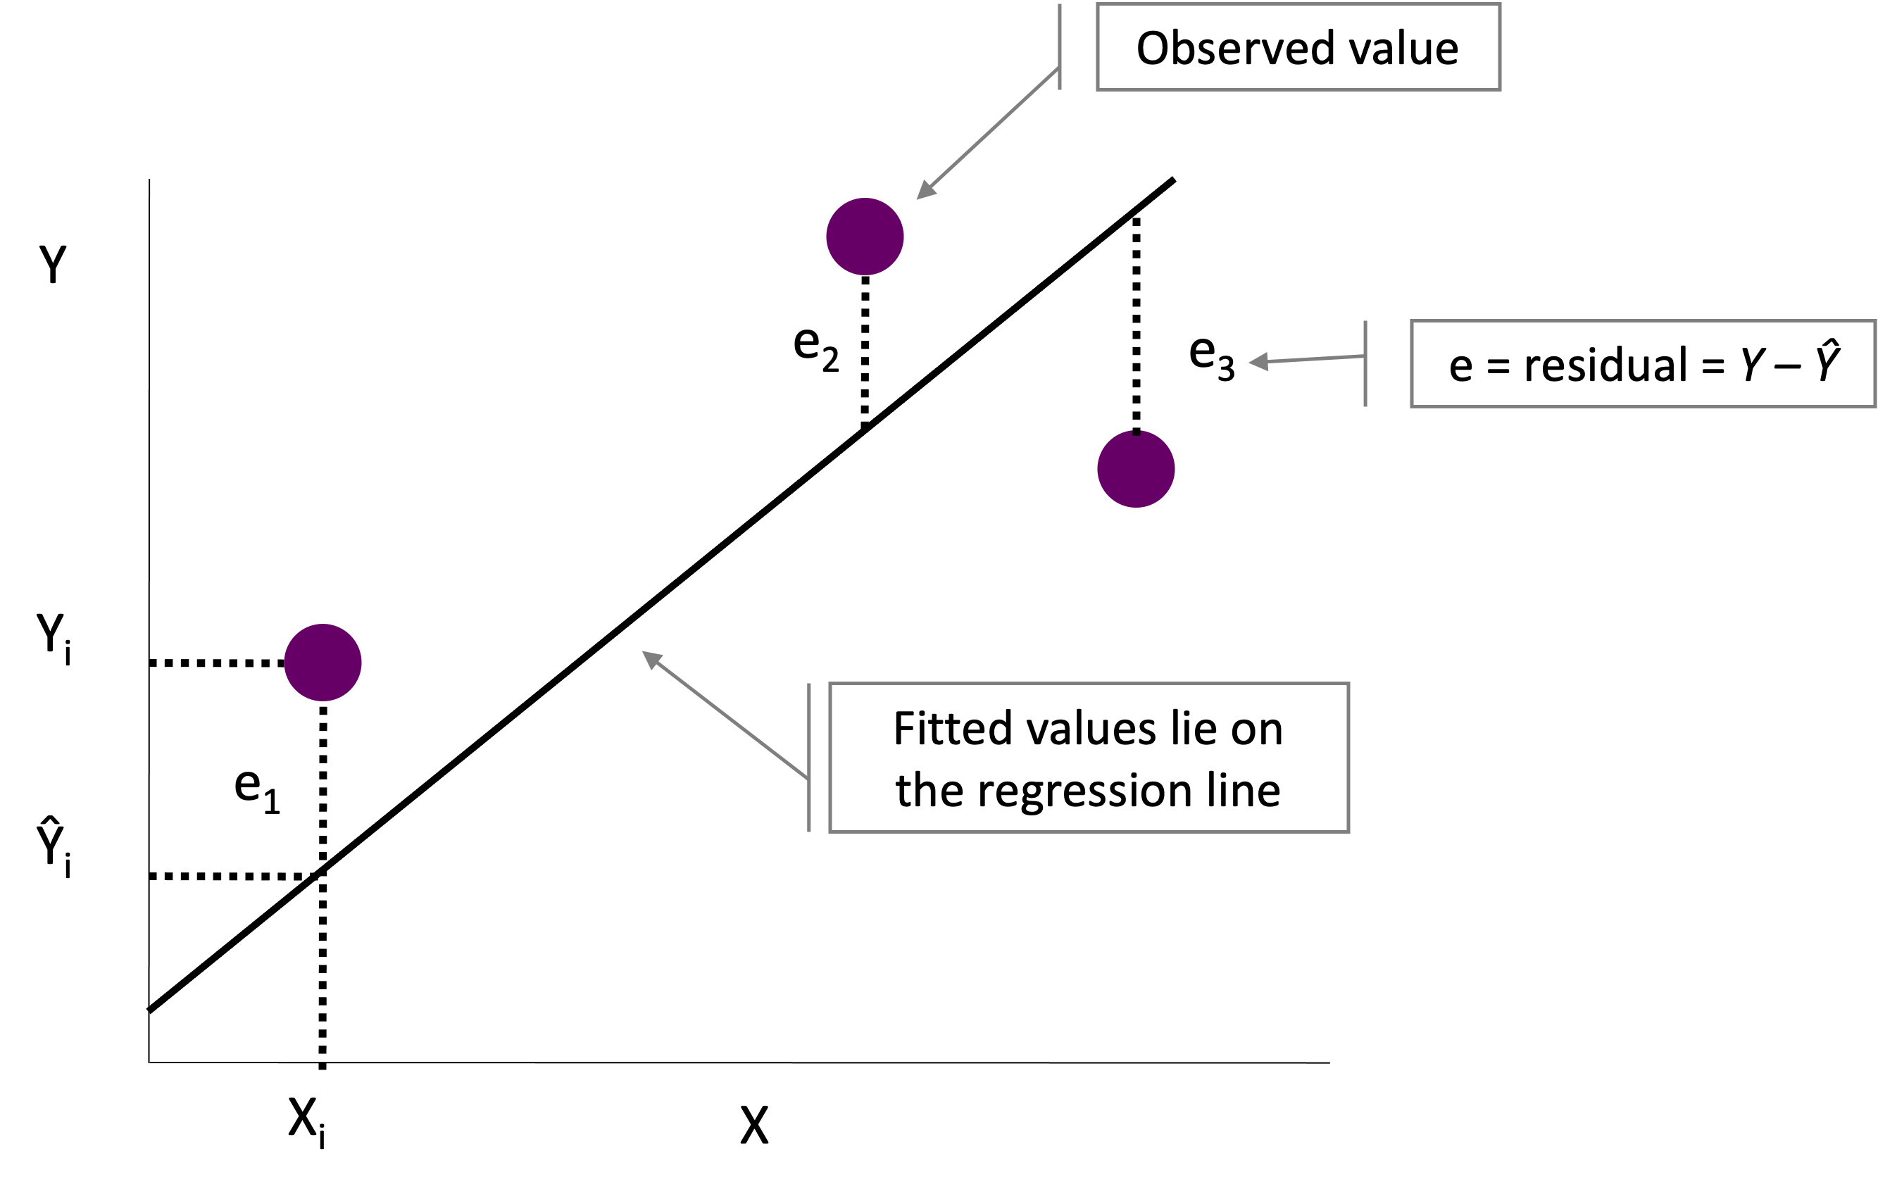
How to find a regression intercept and slope?
A method called ordinary least squares (OLS) can be used to find b0 and b1

Slide 7
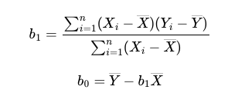
OLS

Slide 8
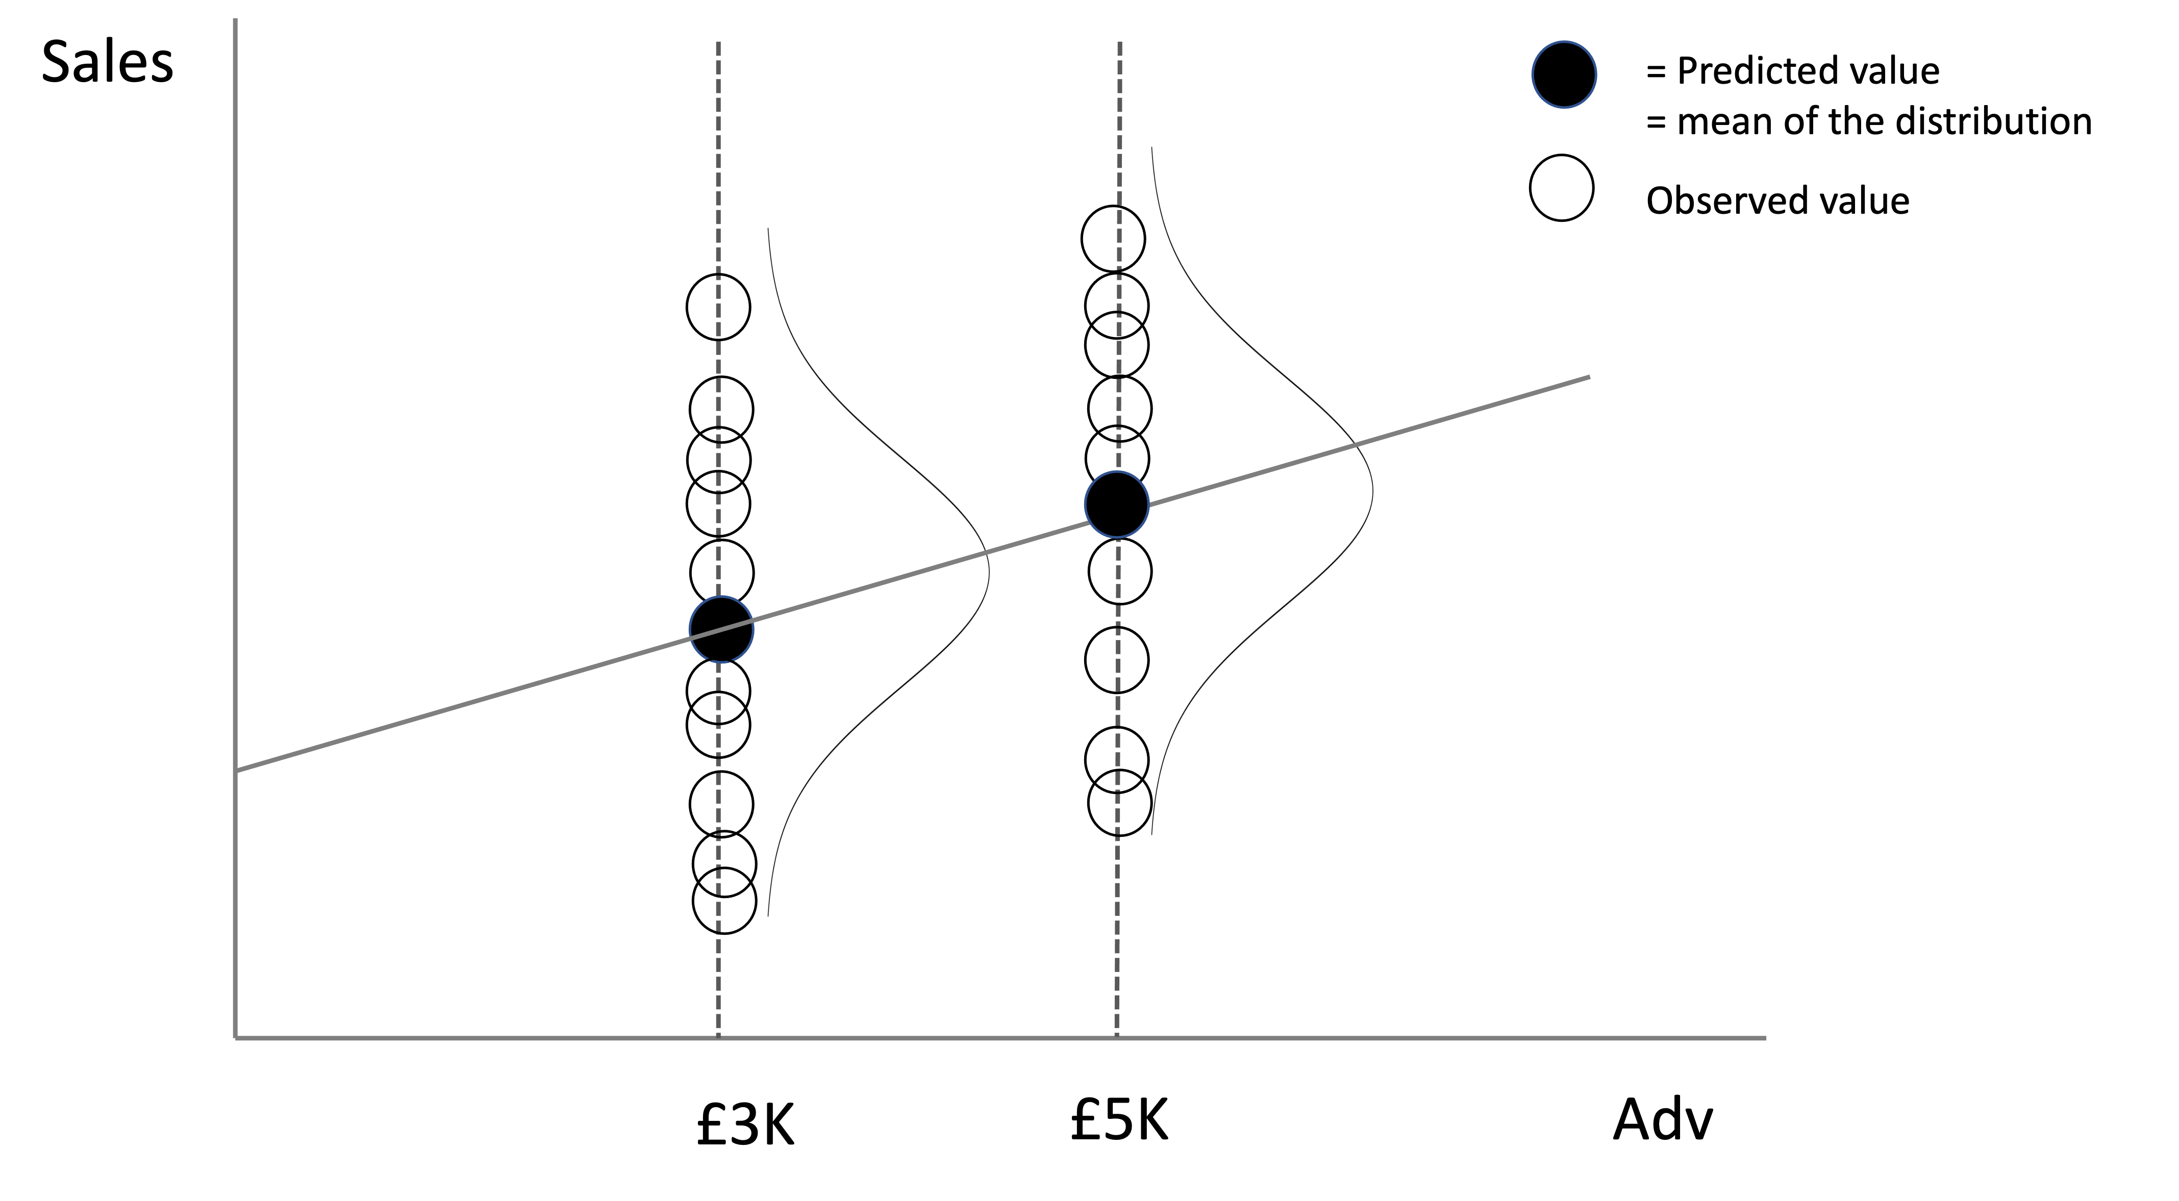
The Best Regression Line Contains Expected Values
All points on the sample regression line are predicted or expected values

Slide 9
Assumptions in Simple Regression
Regression relies on several assumptions. Although, the intercept b0 and slope b1 can be found algebraically, these assumptions are needed to study their statistical properties (e.g., sampling distribution of b1), test their significance, and construct their confidence intervals.
1. Linearity. This assumption requires that the relationship between X and Y is linear.
2. Homoskedasticity. This assumption requires that the residuals must have constant variance.
3. No autocorrelation. This assumption requires that residuals should not be correlated to each other.
4. No endogeneity. Endogeneity refers to a situation where X is correlated with the error term.
5. Residuals are normally distributed. This assumption is not important if our purpose is to assess the significance of the regression estimates of the intercept and slope. It is relevant if we want to make a prediction.

Slide 10
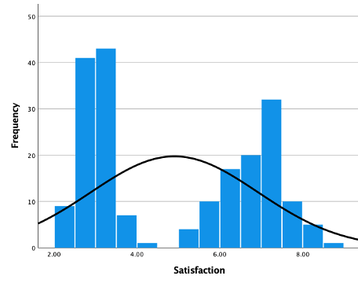
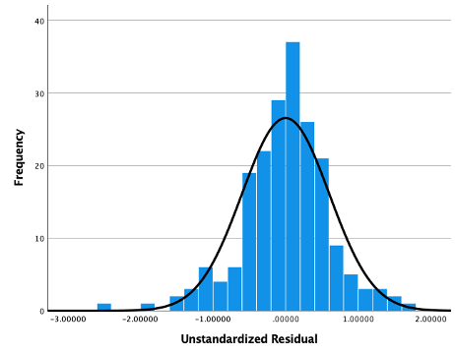
Normality of residuals is not the same thing as normality of Y.
For example, normal residuals can be obtained from Y that is bivariate normal.
Satisfaction Is bivariate normal.
A normal curve is superimposed on the Graph.
Histogram of residuals associated of a simple regression model with satisfaction as a dependent Variable and a binary independent variable

Slide 11
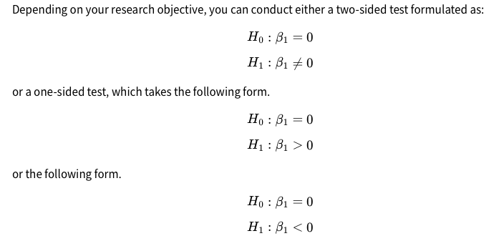
Testing the Significance of the Independent Variable

Slide 12
SPSS Action
get file '/Users/ahmaddaryanto/OneDrive -
Lancaster University/dataspss/sales.sav'
REGRESSION
/MISSING LISTWISE
/STATISTICS COEFF OUTS CI(95) R ANOVA
/CRITERIA=PIN(.05) POUT(.10)
/NOORIGIN
/DEPENDENT Sales
/METHOD=ENTER Adv.

Slide 13
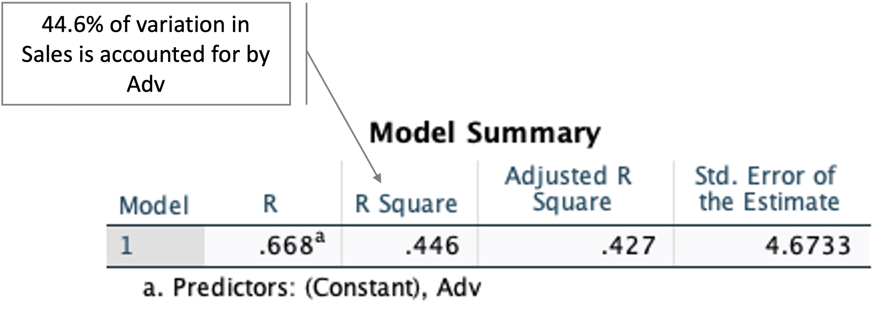
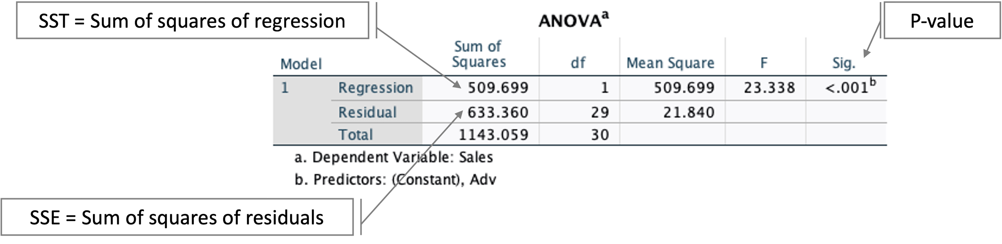
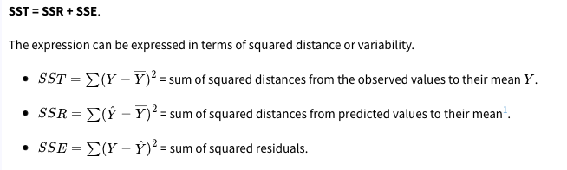
Interpretation of Outputs
Model Summary
ANOVA Table

Slide 14
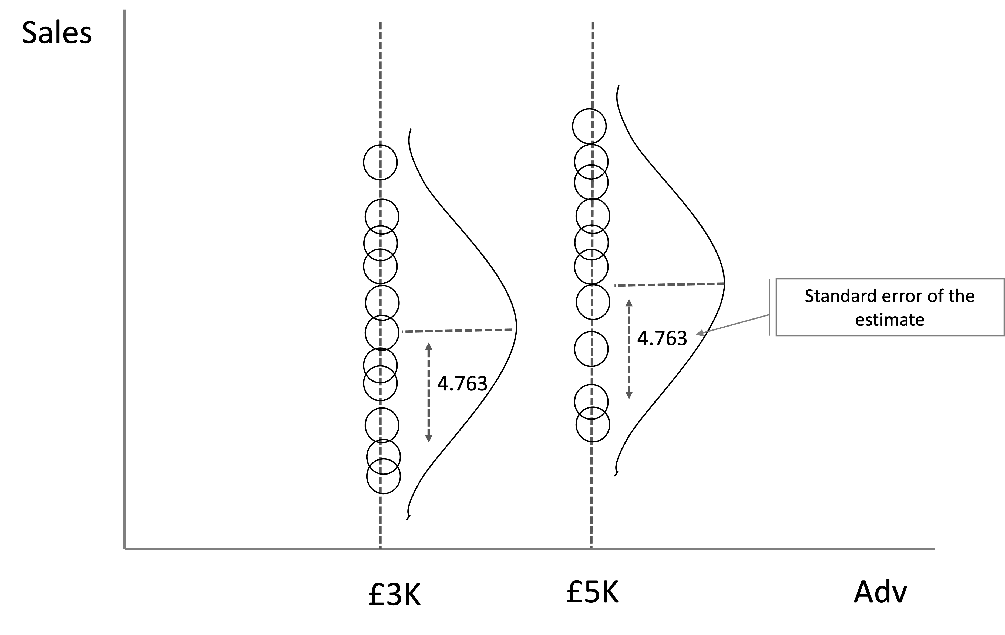
Standard Error of the Estimate

Slide 15
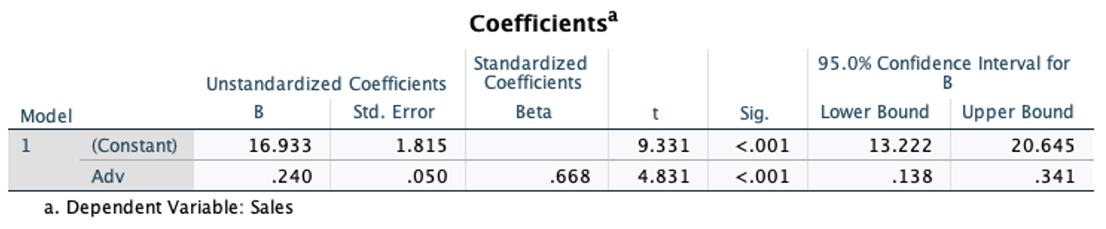
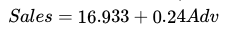
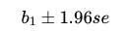
Coefficients Table
The first row of the coefficients table is for b0 displayed as (Constant) in SPSS, and the second row is for the b1. From the Standardized Coefficients part, we see b0=16.933 and b1=0.240. Knowing the constant and the slope, we can write down the equation for the best line as:
The 95% confidence interval for the slope is [0.138, 0.341]. This means we can be 95% confident that β1will fall between 0.0138 and 0.341. If you are curious where these numbers came from, you can compute the lower and upper bound of the 95% confidence interval manually using this formula

Slide 16
The Standardized Coefficients
SPSS also report the standardizes coefficients. The standardized form of the estimated regression model is Sales=0.668Adv. How did we get the the slope = 0.668? The slope can be obtained by regressing the standardized form of Sales on the standardized form of Adv.

Slide 17
R Action
library(haven)
dat <- read_spss("/Users/ahmaddaryanto/Documents/Data1/sales.sav")
lm_sales <- lm(Sales ~ Adv, data = dat)
anova(lm_sales)
summary(lm_sales)
The regression outputs produced by summary() function from R base did not produce standardized coefficients. The lm.beta() package (Behrendt, 2023) can be used to produce standardized coefficient.
library(lm.beta)
lm_sales_std <- lm.beta(lm_sales)
summary(lm_sales_std,standardized=TRUE)

Slide 18
stargazer() package (Hlavac, 2015) can be used to produce regression results, which meet publications standard. Several options are available to format the outputs. For instance, in the code below, single.row=TRUE produces outputs in a row format, and ci=TRUE yields the 95% confidence intervals for the regression estimates. You can find all the options by looking at the package’s help file (type in `?stargazer’ in your R console).
library(stargazer)
stargazer(lm_sales, type = "text", single.row=TRUE, ci=TRUE)
Another package that can produce a nice-looking result is jtools() (Long & Long, 2017). In jtools, summ() function is used to product regression outputs, which is a replacement for summary() of R base. There are several options to format the regression outputs. For instance in the code below confint=TRUE produces the 95% confidence intervals for the regression estimates.
library(jtools)
summ(lm_sales, confint=TRUE)

Slide 19
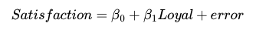
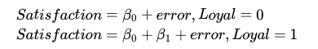
Comparing Differences in Two Means
Suppose that you want to test whether mean satisfaction score of loyal is greater than that of non-loyal customers. You build a regression model
where Loyal is a categorical (0,1) variable with Loyal = 1 if a customer is a loyal customer, and = 0, otherwise. It is important to code a categorical variable as 0,1 when you are dealing with two groups.

Slide 20
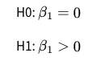
β1 captures the difference between the satisfaction score of loyal and non-loyal customer. β1>0 if the satisfaction score of loyal customer is greater than that of the non-loyal customers. Therefore, the hypothesis test is

Slide 21
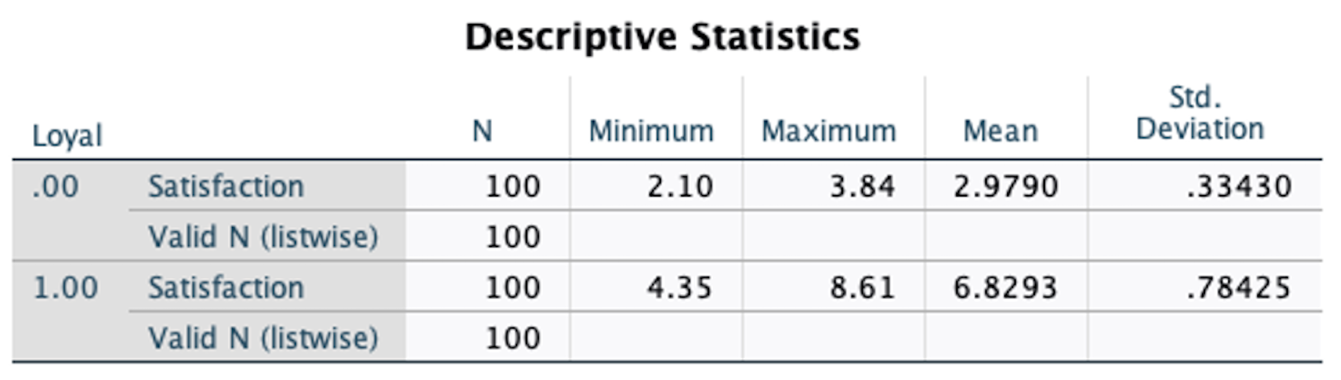
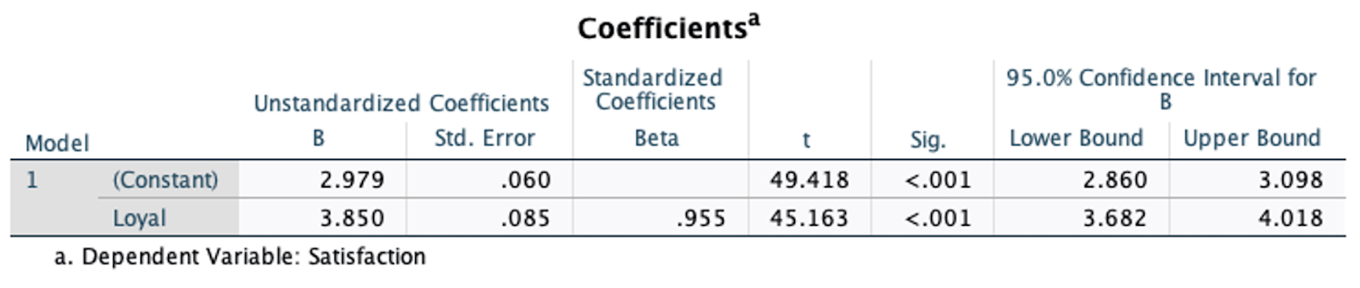
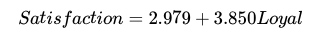
Data: satisfaction.sav
The sample size for the non-loyal group is 100, mean satisfaction = 2.9790, and standard deviation = 0.3343. The sample size for the loyal group is 100, mean satisfaction = 6.8293 and standard deviation = 78425. The mean difference is 6.8293-2.9790 = 3.8503. Is this significantly greater than zero?

Slide 22
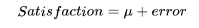
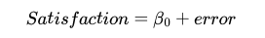
Testing Population Mean
Can we regression to test a population mean, for instance, is mean satisfaction score greater than 0?
The answer is yes. Essentially, you are estimating a population mean using:
where μ is the population mean. This model is the same as:
where the model has no slope and only the intercept β₀ = μ.

Slide 23
Modifying an SLR Model
Log-linear model
If we take the natural logarithm of the dependent variable, then we have a what a so-called log-linear model. For example, Log(Sales)=2.845+0.10∗Adv is a log linear model describing a relationship between log(Sales) and advertising expenditure (Adv).
A regression coefficient in a log-linear regression model represents the estimated percent change in a dependent variable for a unit change in an independent variable.

Slide 24
Modifying an SLR Model
Log-log model
Taking the natural logarithm at the both sides of the model give us the log-log model. For example, Log(sales)=2.282+0.269∗log(Adv) is a log-log model describing a relationship between log(Sales) and log(Adv).Suppose that the unit measurement for Adv is £1K. The regression coefficient for Adv in this particular example means that 1% increase in Adv increases sales by 0.269%.. A log-log model is also called a constant Elasticity model. A log-log model is also widely used for metrics data (ratio variables). A log-log model is also called a constant Elasticity model.
A regression coefficient in a log-log model represents the estimated Elasticity: percent change in a dependent variable for a 1% unit change in an independent variable.

